Slide 1
Aspectos Hidráulicos e Hidrológicos de Segurança de Barragens
Jerry W. Webb, P.E., D.WRE
Principal Hydrologic & Hydraulic Engineer
Hydrology, Hydraulics & Coastal Community of Practice Leader
US Army Corps of Engineers, Headquarters
Jerry.w.webb@usace.army.mil
Oficina de Segurança de Barragens
Brasília, Brasil
20-24 May 2013

Slide 2
Tópicos de Apresentação
Considerações Hidrológicas
Considerações Hidráulicas
Alternativas típicas usadas para corrigir deficiências
Centro de Produção de Modelagem e Mapeamento de Consequências (MMC)
Notes:
Course Objectives. Most of the class come from operations background, so we want to present some of the background aspects of hydrology and hydraulics; from a design standpoint (why are certain features as they appear) and from an O&M standpoint (things to know).
This will cover a wide range of topics, the tie among them being their importance to the ultimate safety of our civil works projects.
Emphasize the critical nature of H&H personnel – both hydraulic and hydrologic – to dam safety.
In aspects of: design, operation, maintenance, and monitoring.

Slide 3
Identificação de Problemas de Segurança de Barragens
64% das Barragens do Corps têm mais de 30 anos de idade
28% já alcançaram ou ultrapassaram sua vida útil (economicamente) conforme projeto de 50 anos
11% (65) das barragens do Corps foram identificadas como sendo deficientes em termos hidrológicos ou sísmicos, com base em metodologias e critérios atuais
Muitos não são testados em termos de condições plenas do reservatório
O custo de consertar estas deficiência é estimado em bilhões de dólares
Source: USACE Risk Analysis for Dam Safety Research Unit (2001)

Slide 4
Documentos Orientadores
Sites com publicações do USACE
http://www.usace.army.mil/publications/
  EM’s, ER’s
    ER 1110-8-2(FR) (Projetos para Vazão de Entrada em Barragens e Reservatórios)
      Padrões de barragens (a classificação baseia-se nos impactos das rupturas)
      Ajustes das Unidades Hidrográficas
      Enchentes Antecedentes
      Lista muitas referências
    EM 1110-2-1415 (Análise de Frequência Hidrológica)
      Orientação baseada no Bulletin 17B
    EM 1110-2-1417 (Análise de Escoamento em Enchentes)
    EM 1110-2-1420 (Requisitos Hidrológicos de Engenharia para Reservatórios)
      Análise de Escoamento em Enchentes
      Análise de Ruptura de Barragens
    EM 1110-2-1413 (Análise Hidrológica de Áreas Interiores)
Notes:
USACE HQ website provides links to all guidance documents. These are some that provide guidance for analysis relating to Dam Safety

Slide 5
Tópicos
Considerações Hidrológicas
Considerações Hidráulicas
Alternativas Típicas para a correção de deficiências
Centro de Produção de Modelagem Mapeamento & Consequências (MMC)
Notes:
Course Objectives. Most of the class come from operations background, so we want to present some of the background aspects of hydrology and hydraulics; from a design standpoint (why are certain features as they appear) and from an O&M standpoint (things to know).
This will cover a wide range of topics, the tie among them being their importance to the ultimate safety of our civil works projects.
Emphasize the critical nature of H&H personnel – both hydraulic and hydrologic – to dam safety.
In aspects of: design, operation, maintenance, and monitoring.

Slide 6
Deficiências Hidrológicas
Galgamento - 34% de todas as falhas (nacionalmente)
  Projeto do Vertedouro foi inadequado
  Bloqueio por Detritos no Vertedouro
  Recalque da Crista da Barragem
Notes:
Overtopping
-Inadequate spillway design-Debris blockage of spillway
-Settlement of dam crest-Foundation defects-Differential settlement

Slide 7
Considerações Hidrológicas
Capacidade Hidrológica!
  Enchente devido ao Projeto de Vazão de Entrada (IDF)
  Condições durante IDF
  Capacidade de saída no Projeto
  Elaboração do Projeto
  Enchente de Limiar
  ER 1110-8-2(FR) - Enchente devido ao Projeto de Vazão de Entrada para Barragens e Reservatórios
Notes:
These are the things we'll run through.
IDF - Inflow Design Flood. The flood hydrograph used in the design of a dam and its appurtenant works particularly for sizing the spillway and outlet works, and for determining maximum temporary storage and height of dam requirements.
BSC - Base Safety Condition. The BSC is met when a dam failure related to hydrologic capacity will result in no increase in downstream hazard over the hazard that would have existed if the dam had not failed.
TH - Threshold Flood. The flood that just exceeds the design maximum water surface elevation at the dam (top of dam minus freeboard). As part of new project design work, this would theoretically be the IDF.

Slide 8
Considerações Hidrológicas
A cheia de Projeto (IDF) ***
  A Cheia utilizada no projeto de uma barragem e estruturas pertinentes (principalmente dispositivos de descarga)
  Cheia Máxima Provável (PMF)
    Para a maioria dos projetos de armazenamento esta foi utilizada como Enchente de Projeto de Entrada
    Quatro Padrões de Segurança de Barragens
Notes:
PMF - Probable Maximum Flood. This is the most severe flood that is considered reasonably possible at a particular location as a result of hydrologic and meteorological conditions.
There are four standards. The standard employed is governed by circumstances associated with the specific project.
Capable of placing human life at risk OR causing a catastrophe should they fail. = PMF
Typically run-of-river, hydroelectric
Analysis shows that failure could be tolerated at some flood magnitude
Small recreational lakes, farm ponds, etc. [less than ~20 AF]

Slide 9
Padrão Hidrológico das Barragens
Padrão | Descrição | Cheia por Projeto de Entrada
1 | Riscos a vidas humanas e propriedades | Cheia Máxima Provável (PMF)
2 | Barragens a Fio d’Água | Não há vazão de entrada inusitada/consegue suportar grandes cheia
3 | Impactos incrementais negligenciáveis devido a falhas | ½ PMF
4 | Pequenas barragens (24K cm) | Enchentes com grande frequencia de ocorrência
Notes:
Standard 1 – Most Corps flood control dams
Standard 2 – Navigation dams and some run of river hydropower facilities
Standard 3 – Impacts must be well documented
Standard 4 – Small ponds with less than 20 acre-feet of storage
Probable maximum flood – Largest flood possible for a particular region
Standard project flood – Significant flood typical for a particular region (500-1000 year)
Base safety condition – Evaluated based on downstream impacts of failure

Slide 10
Critérios Hidrológicos
Precipitação Máxima Provável
  Maior precipitação fisicamente possível para uma área em particular
Cheia Máxima Provável
  Enchente resultante da precipitação máxima provável
Cheia Limiar
  Cheia máxima que uma barragem pode suportar de forma segura

Slide 11
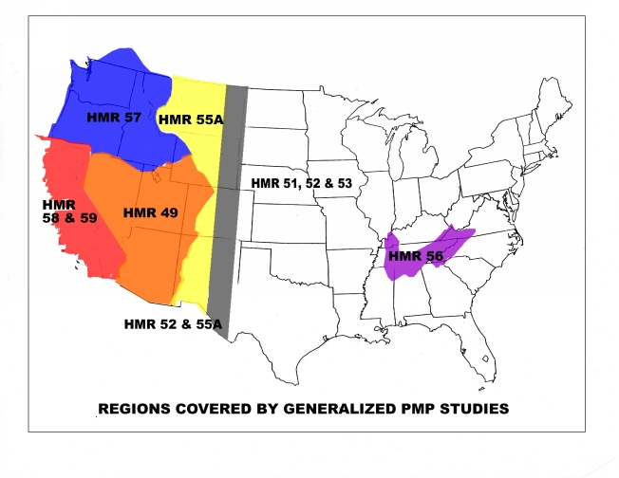
Precipitação Máxima Provável
http://www.nws.noaa.gov/oh/hdsc/currentpmp.htm
HMR= Relatórios Hidrometeorológicos
Notes:
Definition of PMP - "Theoretically, the greatest depth of precipitation for a given duration that is physically possible over a given size storm area at a particular geographical location at a certain time of the year."
PMP - Probable Maximum Precipitation. The theoretically greatest depth of precipitation for a given duration that is physically possible over a given size storm area at a particular geographical location at a certain time of year.
Hydrometeorological Reports Nr. 57, etc. A multi-agency document spear headed by NOAA-NWS to describe the PMP for various geographical areas of the country.

Slide 12
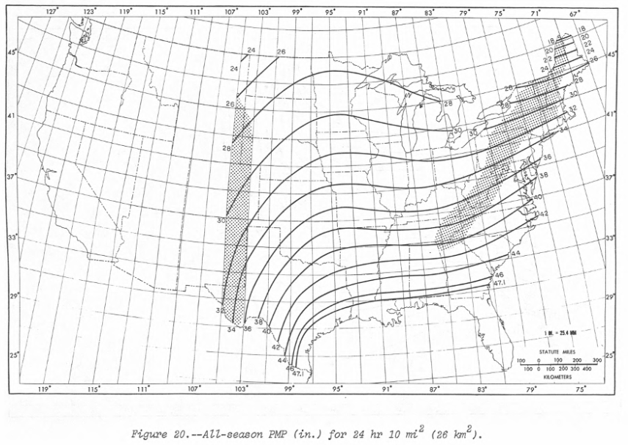
Precipitação Máxima Provável
All-Season PMP (Inches) for 24 Hour / 10 Sq Mi
Notes:
Definition of PMP - "Theoretically, the greatest depth of precipitation for a given duration that is physically possible over a given size storm area at a particular geographical location at a certain time of the year."
PMP - Probable Maximum Precipitation. The theoretically greatest depth of precipitation for a given duration that is physically possible over a given size storm area at a particular geographical location at a certain time of year.
Hydrometeorological Reports Nr. 57, etc. A multi-agency document spear headed by NOAA-NWS to describe the PMP for various geographical areas of the country.

Slide 13
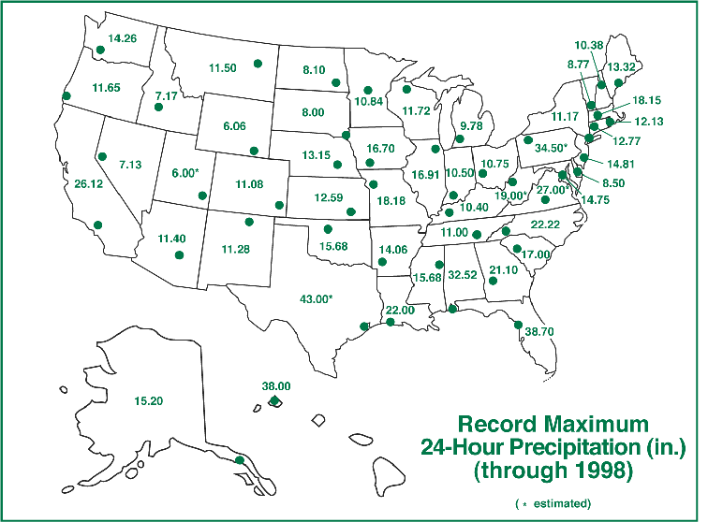
Eventos Extermos de Chuva Ocorrem Sim

Slide 14
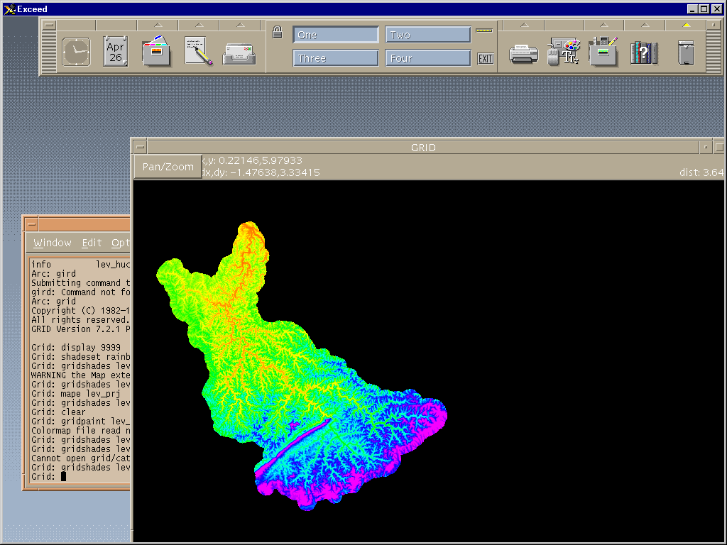
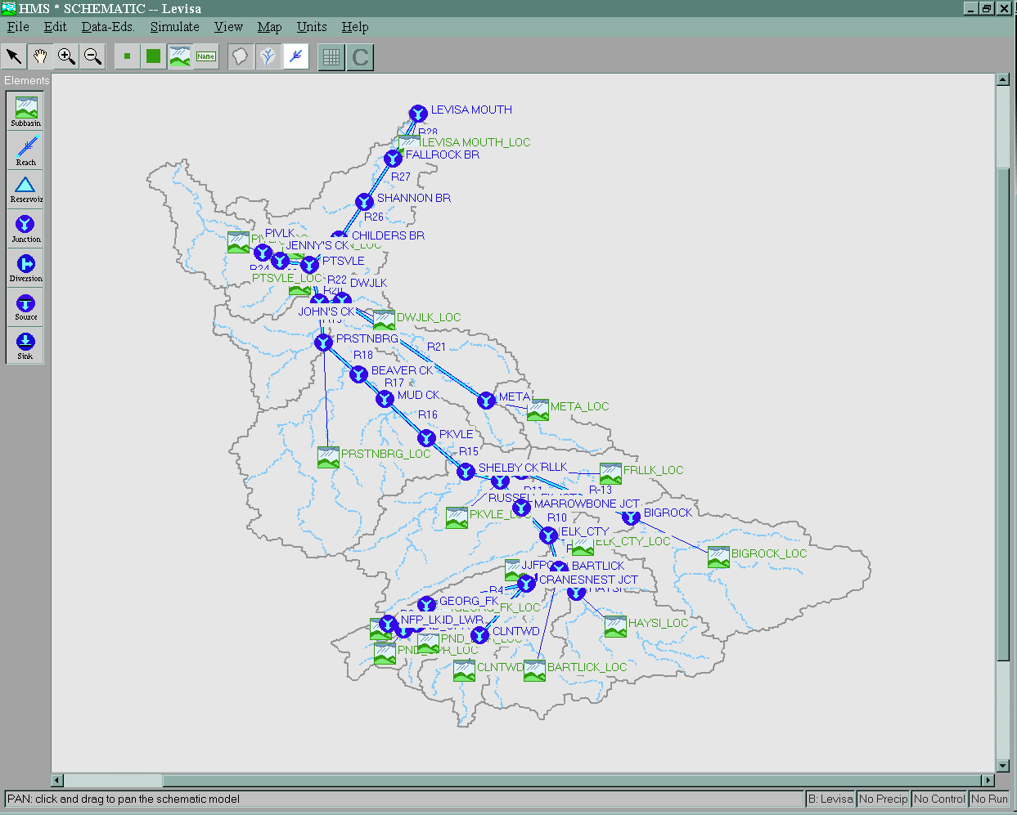
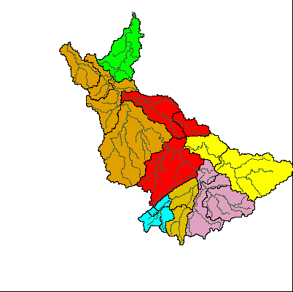
Modelos Hidrológicos
Notes:
Screen captures from GIS software and HEC-HMS

Slide 15
Rotas Hidrológicas
Manuais com procedimentos de controle de água
Volume de armazenamento do reservatório
Dispositivos de Descarga e capacidade do vertedouro
Condições do Histórico
Elevação do reservatório e hidrógrafos de vazão de saída
Hidrógrafo de Vazão de Entrada
Armazenamento no Reservatório
Hidrógrafo de Saída
Notes:
Antecedent conditions
ER 1110-8-2(FR) – ½ IDF with 5 day dry period or flood control pool
NWS (Ohio River Basin) – 0.30 IDF with 3 day dry period or 0.39 IDF with 5 day dry period

Slide 16
Hidrógrafos
Top of Dam
Spillway Crest

Slide 17
Objetivo da Garantia de Segurança de Barragens
ER 1110-2-1156 Segurança de Barragens – Políticas e Procedimentos - “O Programa de Garantia de Segurança de Barragens prevê a modificação de barragens e instalações do USACE quando necessário para efeito de segurança em vista de novos dados hidrológicos ou sísmicos ou de mudanças no estado da arte de projetos ou critérios de construção.”

Slide 18
Considerações Hidrológicas
O IDF (PMF) foi alterado?
A curva de elevação de armazenamento alterou-se devido à sedimentação?
Limites de Controle de fluxo a jusante podem ter mudado; invasão da várzea
Limitações operacionais: não se pode ultrapassar a elevação devido a questões geotécnicas…

Slide 19
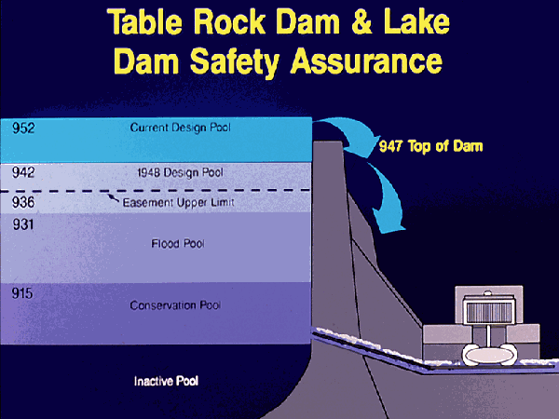
Courtesy USACE Little Rock

Slide 20
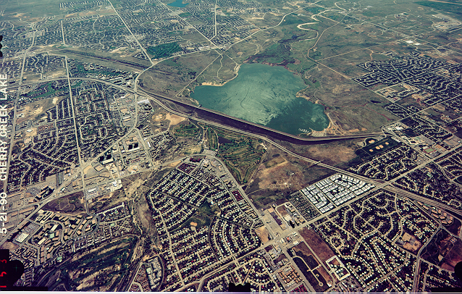
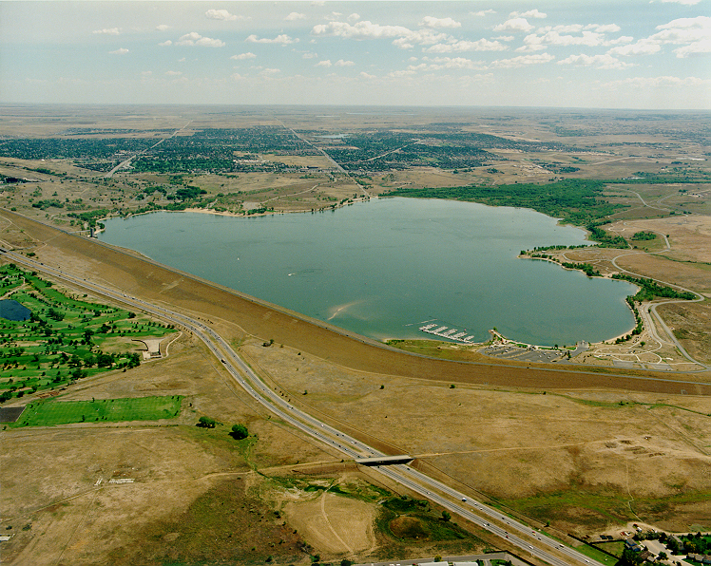
Barragem Cherry Creek

Slide 21
Tópicos
Considerações Hidrológicas
Considerações Hidráulicas
Alternativas típicas usadas para corrigir deficiências
Centro de Produção de Modelagem Mapeamento e Consequências (MMC)
Notes:
Course Objectives. Most of the class come from operations background, so we want to present some of the background aspects of hydrology and hydraulics; from a design standpoint (why are certain features as they appear) and from an O&M standpoint (things to know).
This will cover a wide range of topics, the tie among them being their importance to the ultimate safety of our civil works projects.
Emphasize the critical nature of H&H personnel – both hydraulic and hydrologic – to dam safety.
In aspects of: design, operation, maintenance, and monitoring.

Slide 22
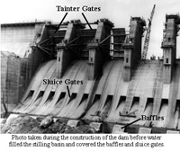
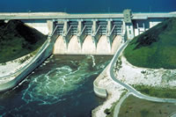
Considerações Hidraúlicas
Componentes Hidráulicos
Integridade Hidráulica!
Notes:
At issue are hydraulic "features;" spillways, outlets, sluices, gates, pumps, navigation locks, etc.
Hydraulic Integrity. Many definitions of "integrity" but from an hydraulic standpoint we are interested in "dependability" and "reliability."

Slide 23
Considerações Hidráulicas
Comportas de Vertedouros
  Elas são inspecionadas durante as inspeções periódicas?
  Regulagens da Comporta: como sabemos que a comporta de fato tem abertura de 70cm
  Operações noturnas
  Você tem problemas de vórtex ou cavitação?
  Você tem requisitos de padrões de vazão? (Estes podem causar erosão na bacia de dissipação)
Notes:
Are the gates inspected? Ours are rotated via the periodic inspection program every 5 years or so.
The Dalles trunion pin. – Seized pin found during a periodic inspection. This is on a spillway gate (1 of 23) which are routinely used. This is a run-of-river project.
Are the gates tested (operated)? Gage indications for openings.
All mechanics are operated every fall. Usually this means without a load. But prior to winter flood control season anyway.
Is there Full-time staff at the Project?
Vortex – Uneven spillway gate openings for example. Or at Red Rock Dam all gates open the same, but tremendous vibrations, breaking gate cables (replaced with stainless steel cables and replace about every 5 years).
Cavitation – more later
Flow Patterns – for example for fish attraction…

Slide 24
Considerações Hidráulicas
Canal do Vertedouro
  Revestido (com concreto) ou não revestido
  Ação de ondas no final do canal
  Ondas Cruzadas
  Problemas de erosão no canal (rugosidade aumentada)
  Problemas com Juntas
  A vegetação pode impedir fluxos
    Fluxos de lavagem, aspersão, remoção de vegetação

Slide 25
Considerações Hidráulicas
Bacia de Dissipação
  Problemas de erosão podem resultar na redução do nível a jusante, que reduz a dissipação de energia
  Problemas de erosão nos “baffle blocks”
  Problemas de erosão por de baixo no lado a jusante da bacia de dissipação
  Detritos (grandes rochas) na bacia podem causar problemas de erosão
Notes:
Baffle Blocks
· Bonneville Dam (Col River) has had almost all replaced in the mid-1950s
Stilling Basins
·The Dalles (Col River) had a large portion eroded right after construction. So we maintain close watch. Now, because we are looking at some modifications to the spillway for fishery operation, we are looking into the issue in more depth.
· We always try to get post flood surveys (large floods), especially on the Columbia. And divers if necessary to inspect or ROVs w/film.
· Hills Creek. The impact zone for the flip Regulating Outlets completely took out the concrete slab. It was founded on rock, but, of course, we watch it closely anyway.

Slide 26
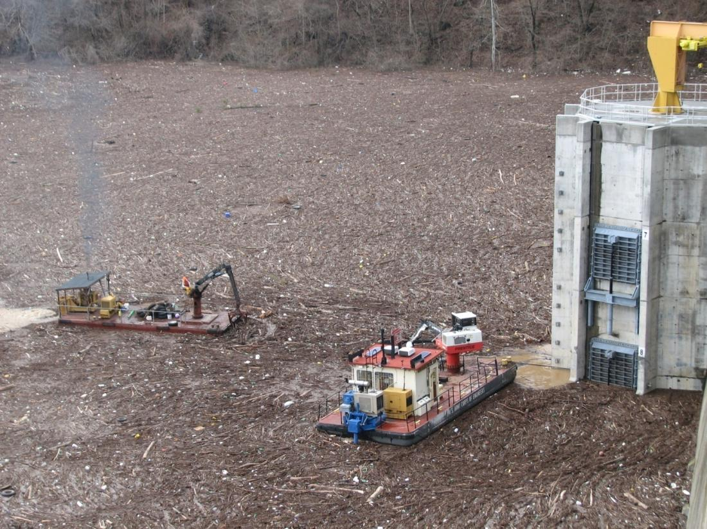
Avaliação de Risco Operacional
Evento de Enchente em março de 2010 BLN
Notes:
26

Slide 27
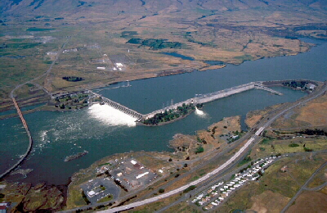
Considerações Hidráulicas
A Barragem Dalles
Notes:
The Dalles Dam spillway and stilling basin showing even releases. By closing selected gates, the pattern may change dramatically – erosion of the stilling may increase…
Constructed: 1960 (units 1-14); 1973 additional units 15-22 completed
Full Pool: 160.0 feet
Nameplate capacity: 14 @ 78 MW, 8 @ 86 MW, 1780 MW total
Stations service units: 2 @ 3 MW, 6 MW total
Hydraulic capacity: 375 kcfs
Spillway: 1380 feet, 23 gates

Slide 28
Considerações Hidráulicas
Regulação de saídas
  Cavitação pode causar problemas
  Requisitos mínimos e máximos de vazão
  Zonas de transição (zonas turbulentas)
  Problemas de aço quebradiço em projetos mais antigos, problemas com condutos forçados
  Problemas na entrada, sedimentos e grade de lixo
      Controle de Operações e temperatura
Notes:
Cavitation – Pumps, engines, air foils, and for our purposes low pressure areas in channels and tunnels, etc.
cav.i.ta.tion \ kav' i ta' shun \ n [1. the rapid formation and collapse of vapor pockets in a flowing liquid in regions of very low pressure. 2. such a pocket formed.] (Webster)
Transition Zones - Both open channel flow to pressure flow during changes in operation and within the outlets at bifurcations, etc.
Trash Racks – At Savage Rapids Dam on the Rogue, a small irrigation diversion dam, there were continuous problems with accumulations of aquatic growth. Used summer hires on a full time basis to keep the structure and outlets clean. Changed the operation at Lost Creek dam (upstream) to modify the water temperatures in the lower reach at Savage Rapids. Stopped growth, virtually eliminated the problem.
Temperature Control - transition among ports, submergence, etc.

Slide 29
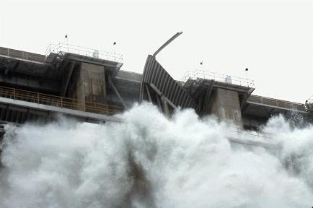
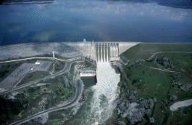
Considerações Hidráulicas
Barragem Folsom
Julho de 1995
Notes:
Pin broke at Folsum Dam and 40K cfs cam rushing through, nearly 40% of the lake was drained before the gate was repaired.

Slide 30
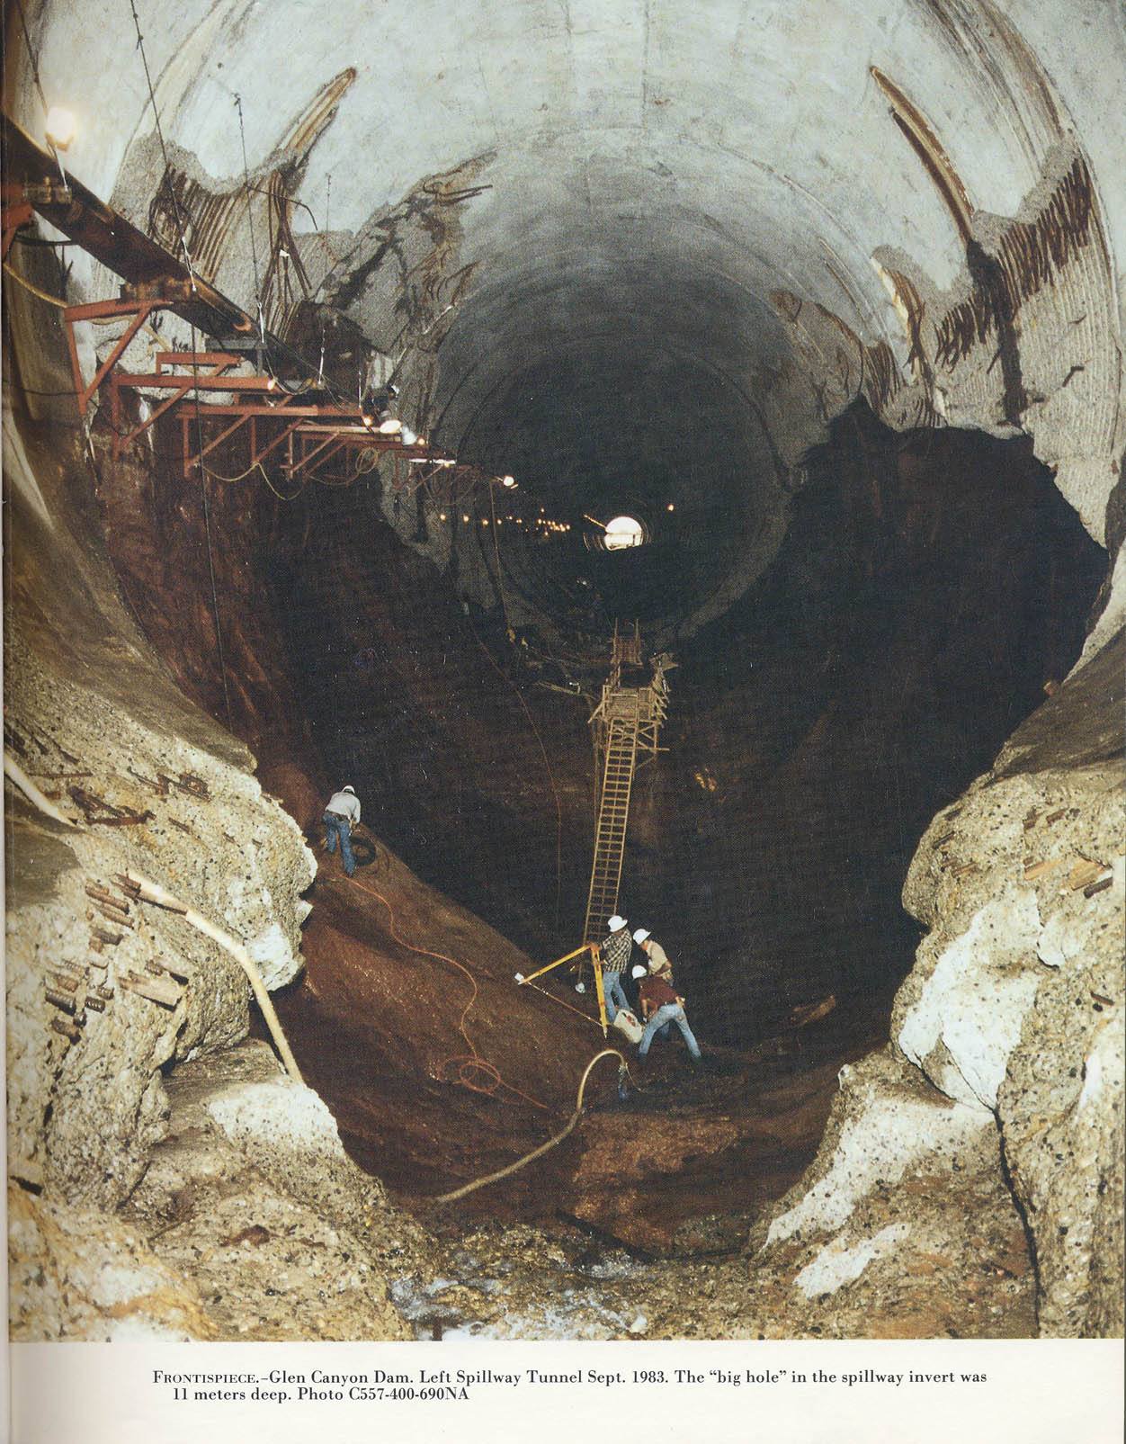
Erosão na Barragem Glen Canyon
Barragem Glen Canyon, túnel de vertedouro esquerdo. Setembro de 1983.
O “grande buraco” no vertedouro foi de 11 metros de profundidade.
Notes:
Glen Canyon Dam
The dam has two huge spillways, one on each side. These are 41 feet in diameter, and have a capacity of 104, 000 cubic feet per second each. There are 4 outlet valves connected to 8-foot outlet tubes designed to discharge water around the power plant. Water can also be released through a tunnel once used to divert water during construction of the dam.
This system was put to the test in 1983 when a late regional winter storm system increased the snow level by 200% of normal, then began to melt quickly. Lake Powell was already at a high level, so water needed to be released to make room for the heavy snow-melt. Even with the dam wide open, the lake continued to rise for weeks but was eventually controlled. Because of the high run-off that year, all the Colorado River dams released excess water causing some flooding downstream on the lower portions of the river.

Slide 31
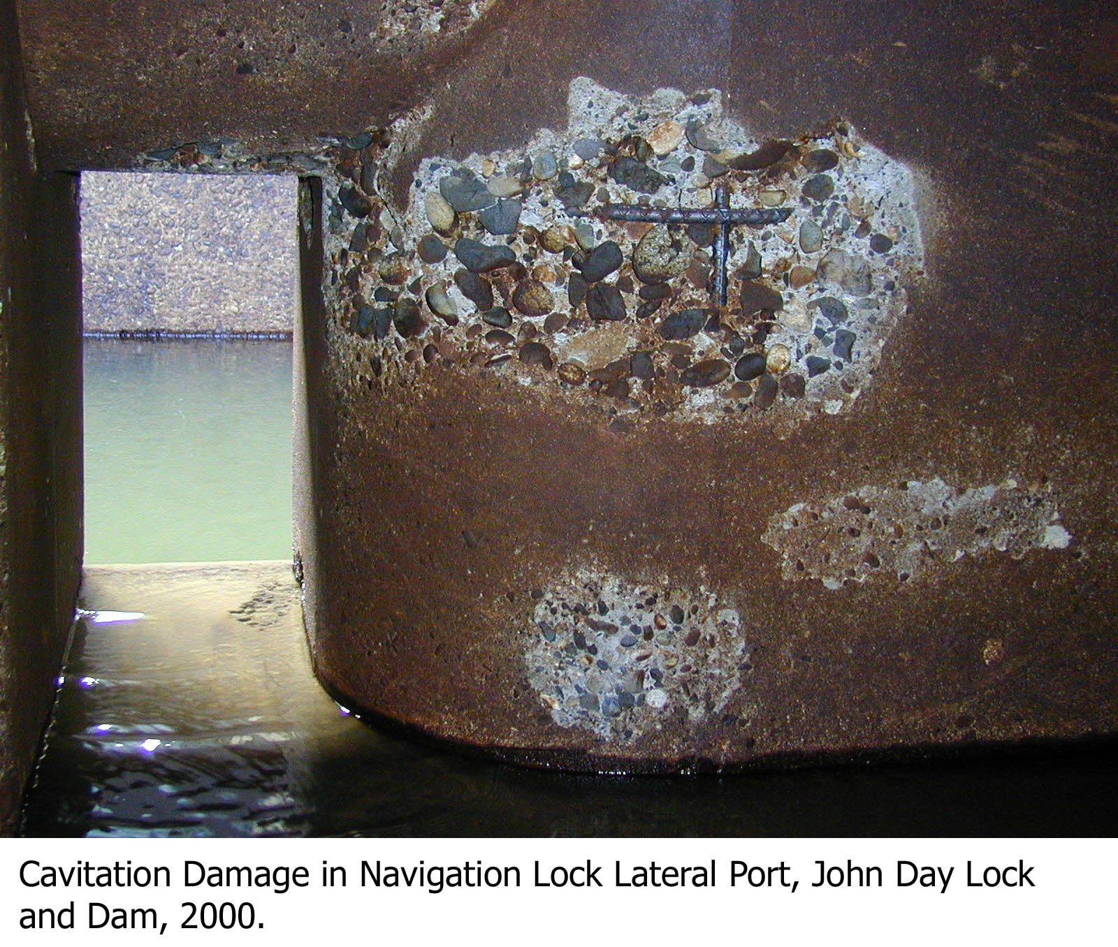
Cavitação Na Eclusa de Navegação John Day Nav

Slide 32
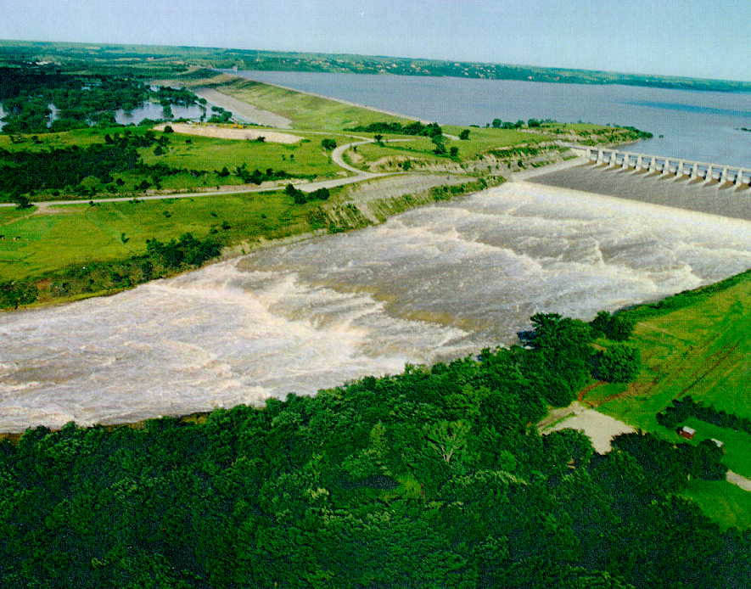
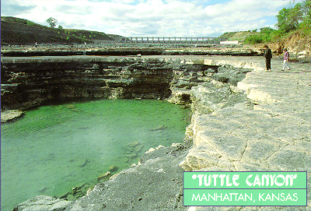
Erosão no Vertedouro: Tuttle Canyon
Tuttle Canyon
Manhattan KS
Notes:
23
23
The value of the dam was proven during the Great Flood of 1993, when floodwaters reaching up to 63 feet (19 m) above normal were held back. However, when the dam reached capacity in July 1993, it necessitated the first release of the spillway. All 18 gates on the spillway were raised 4 feet (1.2 m) during the peak of the flood, producing a flow rate of 60,000 cubic feet per second (1,700 m³/s). The roar of the water was audible half a mile (800 m) away and some people in nearby Manhattan reported hearing the noise. After three weeks the gates were closed, revealing a 20-foot (6.1 m) deep canyon that had been carved in the earth of the spillway channel. The exposed rock is 290 million years old. Locally, this area is known as "The Canyon" and is a popular fossil-hunting area.

Slide 33
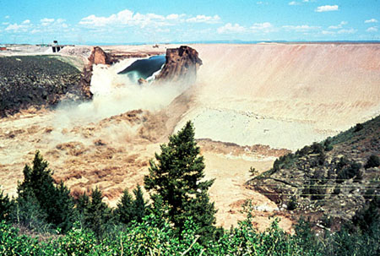
Avaliação Hidráulica
Parâmetros de Ruptura
Inundação
Tempo de passagem da onda de enchente
Tempo de aviso
População em risco
Mortes

Slide 34
Avaliação de Efeitos a Jusante
Descarga
Geometria do canal
Rugosidade (n de Manning)
Estruturas (pontes, barragens, diques)
Perfis de superfícies d’água e mapas de inundação
  Comparação com condições naturais

Slide 35
Tópicos
Considerações Hidrológicas
Considerações Hidráulicas
Alternativas típicas usadas para corrigir deficiências
Centro de Produção de Modelagem Mapeamento e Consequências (MMC)
Notes:
Course Objectives. Most of the class come from operations background, so we want to present some of the background aspects of hydrology and hydraulics; from a design standpoint (why are certain features as they appear) and from an O&M standpoint (things to know).
This will cover a wide range of topics, the tie among them being their importance to the ultimate safety of our civil works projects.
Emphasize the critical nature of H&H personnel – both hydraulic and hydrologic – to dam safety.
In aspects of: design, operation, maintenance, and monitoring.

Slide 36
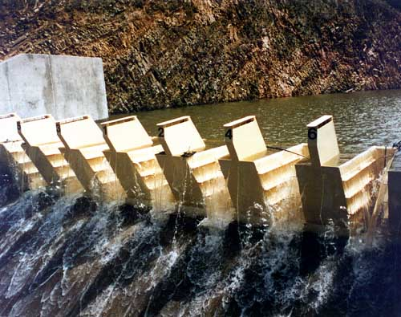
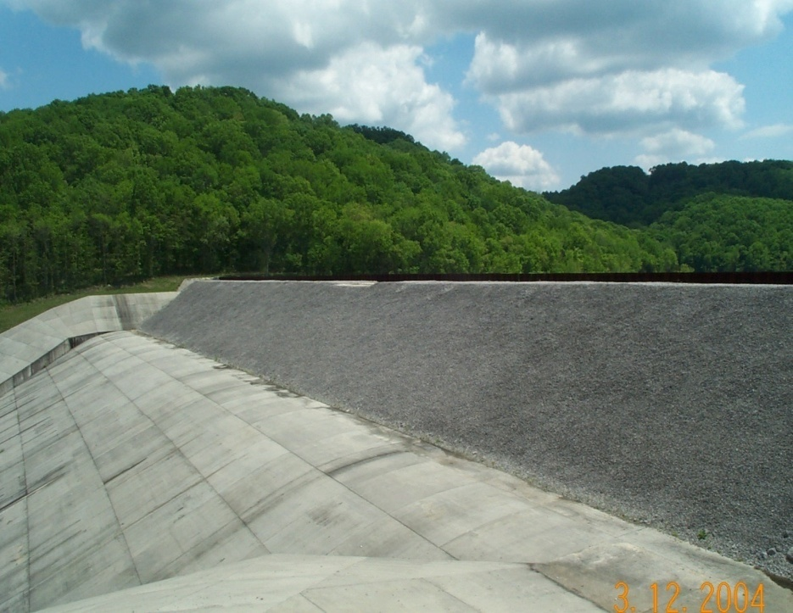
Remediação
Vertedouro Tipo Fusível
Vertedouro Tipo Comporta Fusível
Notes:
Fusegate – Increase storage capacity for nominal floods. Designed to tip over when overtopped by significant floods to increase discharge capacity.
Fuseplug – Erodible embankment material to increase storage capacity for nominal floods. Designed for controlled erosion during significant floods to increase discharge capacity.

Slide 37
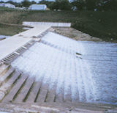
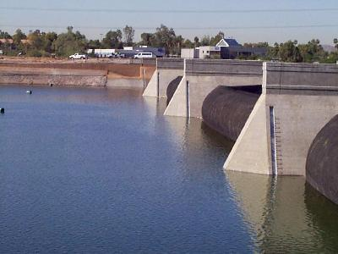
Remediação
Barragem inflável
Transbordamento
Notes:
Overtopping – RCC or other armoring to allow safe overtopping of dam.
Inflatable dam – Polyethylene bladder that can be filled with water to act as a retention structure. Increases storage capacity.

Slide 38
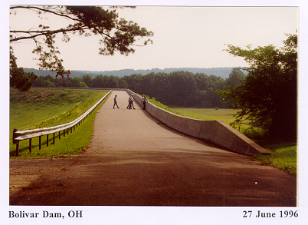
ALTERNATIVAS TÍPICAS DO PROGRAMA DSA
PARAPET WALL

Slide 39
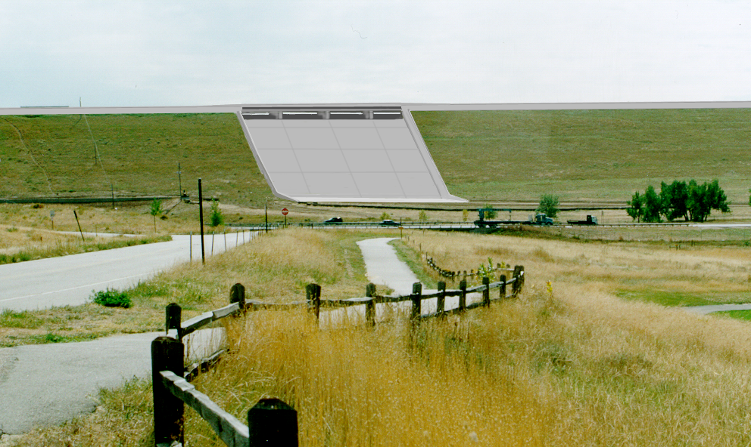
ALTERNATIVAS TÍPICAS
DO PROGRAMA DSA
Combined Parapet & Spillway Modification

Slide 40
Tópicos
Consideraçãoes Hidrológicas
Considerações Hidráulicas
Alternativas típicas usadas para corrigiar deficiências
Centro de Produção de Modelagem Mapeamento e Consequencias (MMC)
Notes:
Course Objectives. Most of the class come from operations background, so we want to present some of the background aspects of hydrology and hydraulics; from a design standpoint (why are certain features as they appear) and from an O&M standpoint (things to know).
This will cover a wide range of topics, the tie among them being their importance to the ultimate safety of our civil works projects.
Emphasize the critical nature of H&H personnel – both hydraulic and hydrologic – to dam safety.
In aspects of: design, operation, maintenance, and monitoring.

Slide 41

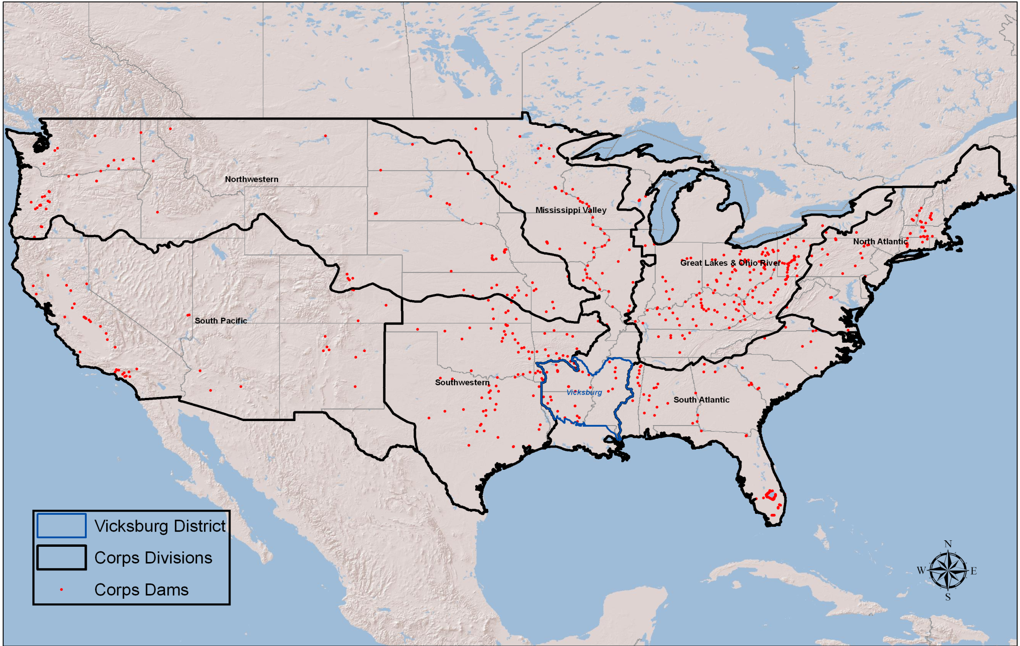
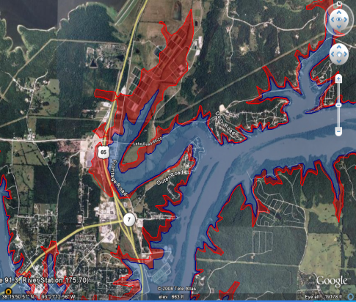
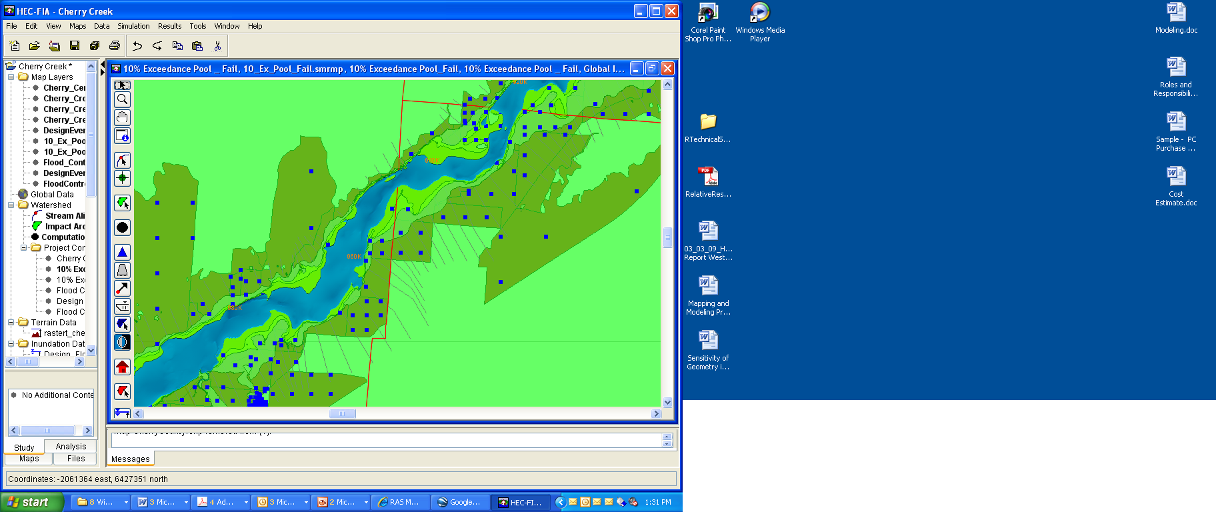
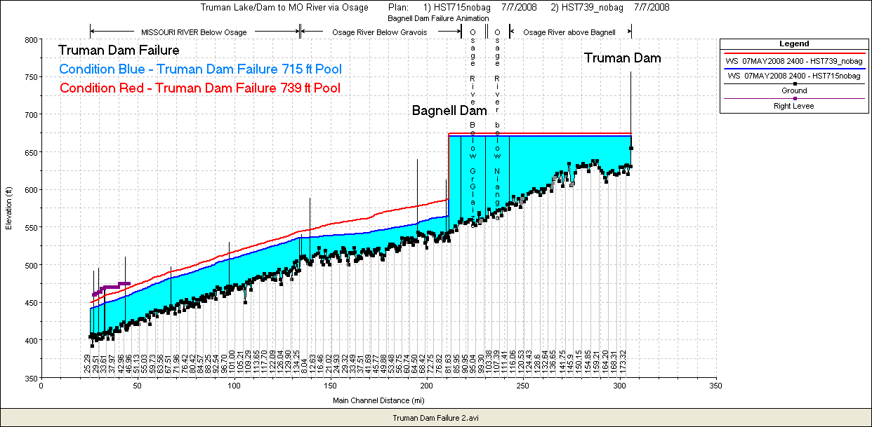
Centro de Produção de Modelagem, Mapeamento e Consequências
MMC Pessoal Virtual H&H, SIG, Economista

Slide 42
Por que formar o Centro de Produção de MMC?
Padrões consistentes, especificações e produtos
Produção Efetiva em termos de custos
Manter competência técnica local em HH&C, SIG e COPs dos economistas
Programas originais
  Proteção e Resiliência na Infraestrutura Crítica (CIPR)
  Segurança de Barragens e Segurança de Diques
Prioridades estabelecidas pela Sede baseadas em DSAC/IES & CIPR
MMC funciona sob a direção do Comitê Diretor do MMC

Slide 43
Produtos de MMC
Modelagem
  Modelos Hidráulicos Georreferenciados Instáveis
    1D – HEC-RAS
    2D – Flo 2D – (HEC-RAS com Capacidade 2D)
  Modelos disponíveis via RADSII de tal forma a serem modificados para simular eventos em tempo real
  Modelos serão disponíveis para uso pelo Distrito
    Pode ser complementado com Novos Dados e retornado a RADSII após a revisão
    Pode ser modificado para ser usado em vários tipos de estudo para Missões do Distrito
Mapeamento
  Arquivos Digitais para 10 cenários
  Mapeamento de registrtos para 2 cenários como suporte aos PAEs
  Arquivos Corpmap
  Animação KMZ (Arquivos Google Earth)
Estimativas de Consequencias
  Estimativa de Consequencias Detalhadas de forma a incluir PAR, LOL, Danos Totais.
  Os resultados apóiam Proteção de Infraestrutura Crítica e Programa de Resiliência
    Fichas CTS
    Relatórios de Projetos (Relatório de Avaliação de Consequencias)
  Permite que a Segurança de Barragens categorize o inventário de acordo com o risco e prioridades de financiamento

Slide 44
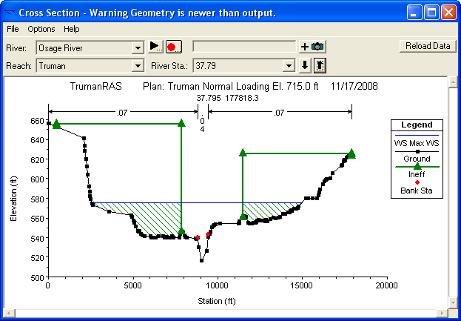
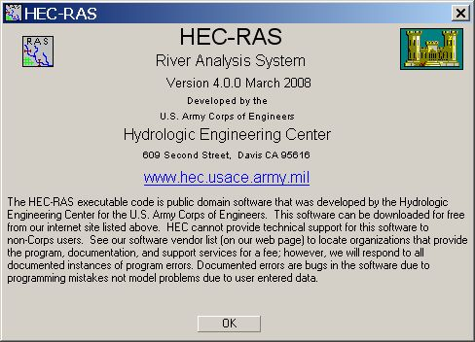
Dez Cenários Modelo Padrão
Cinco para condições de falhas e cinco para condições sem falhas
  Cota baixa normal – 90% de duração de excedência
  Cota alta normal – 10% de duração de excedência
  1% reservatório de excedência – 1% de duração de excedência
  Topo do armazenamento ativo – Projeto dimensionado para tempestades e PMFs
  Cota máxima do reservatório - Projeto dimensionado para tempestades e PMFs
Notes:
Scenarios that the MMC is producing for Each Dam. Underline scenarios are the ones that are mapped in EAP books

Slide 45
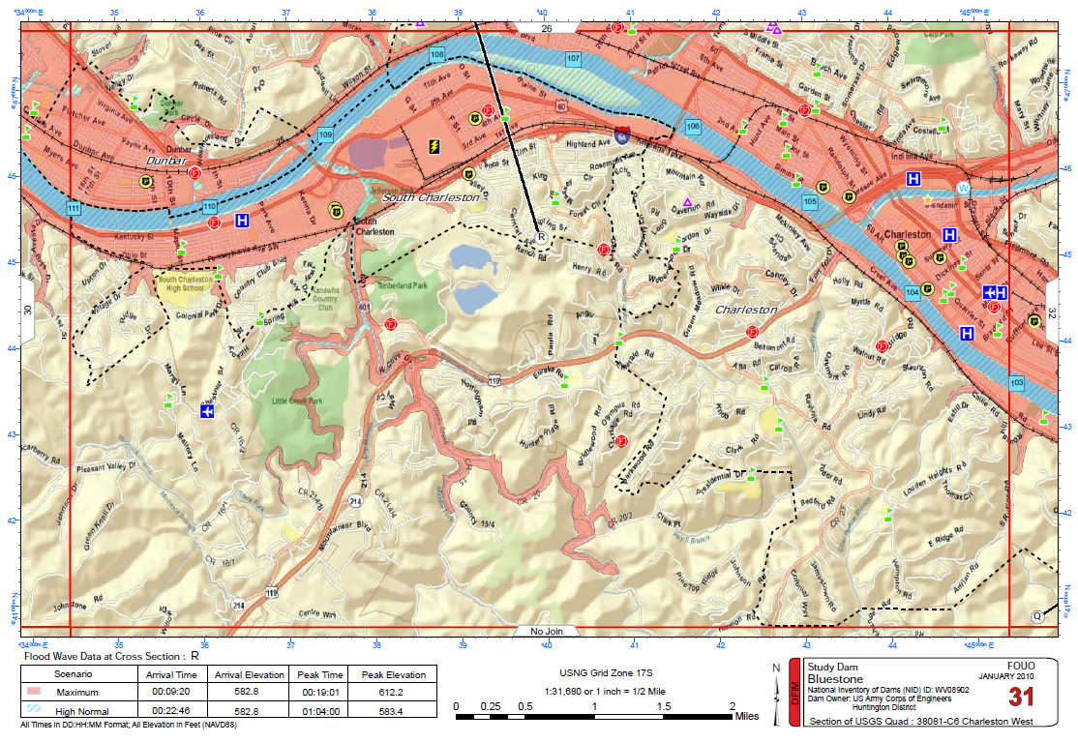
PAE vista do mapa de ruas

Slide 46
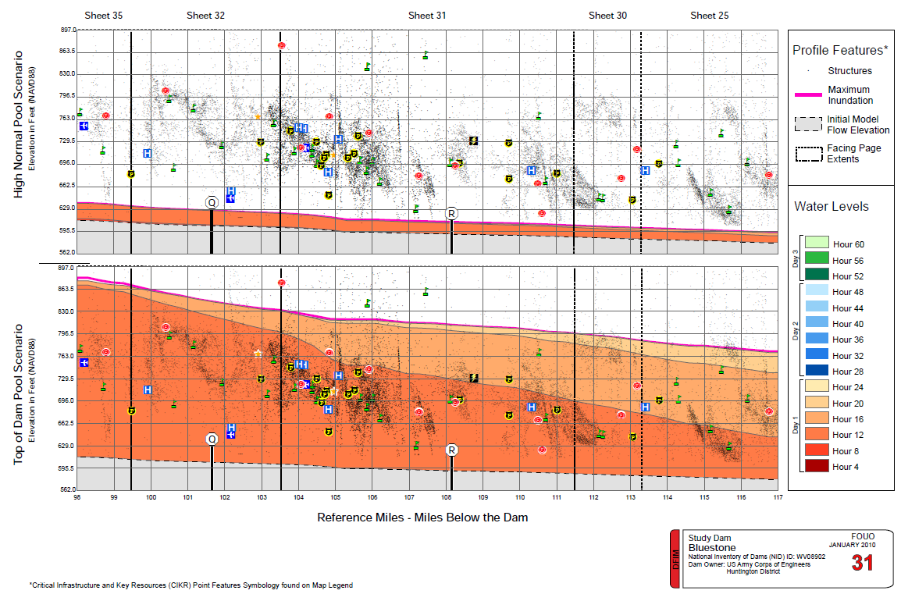
Flood Profile – Facing PagesF
Vista do Perfil de Enchente

Slide 47
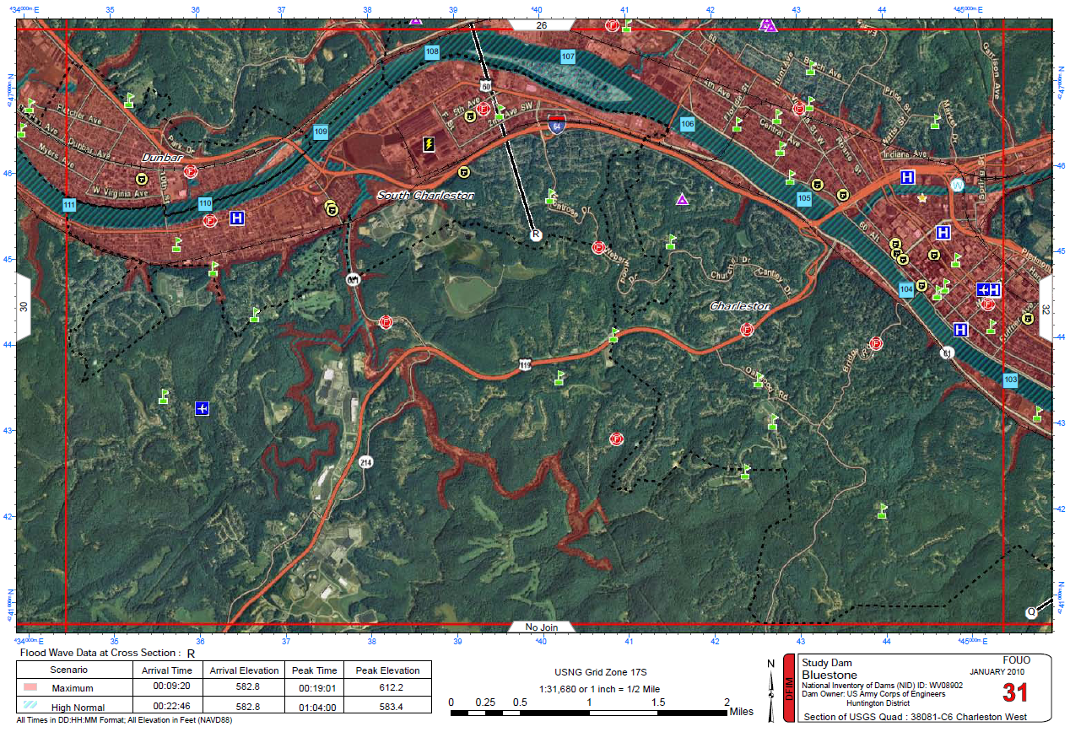
Vista de Mapa Aéreo

Slide 48
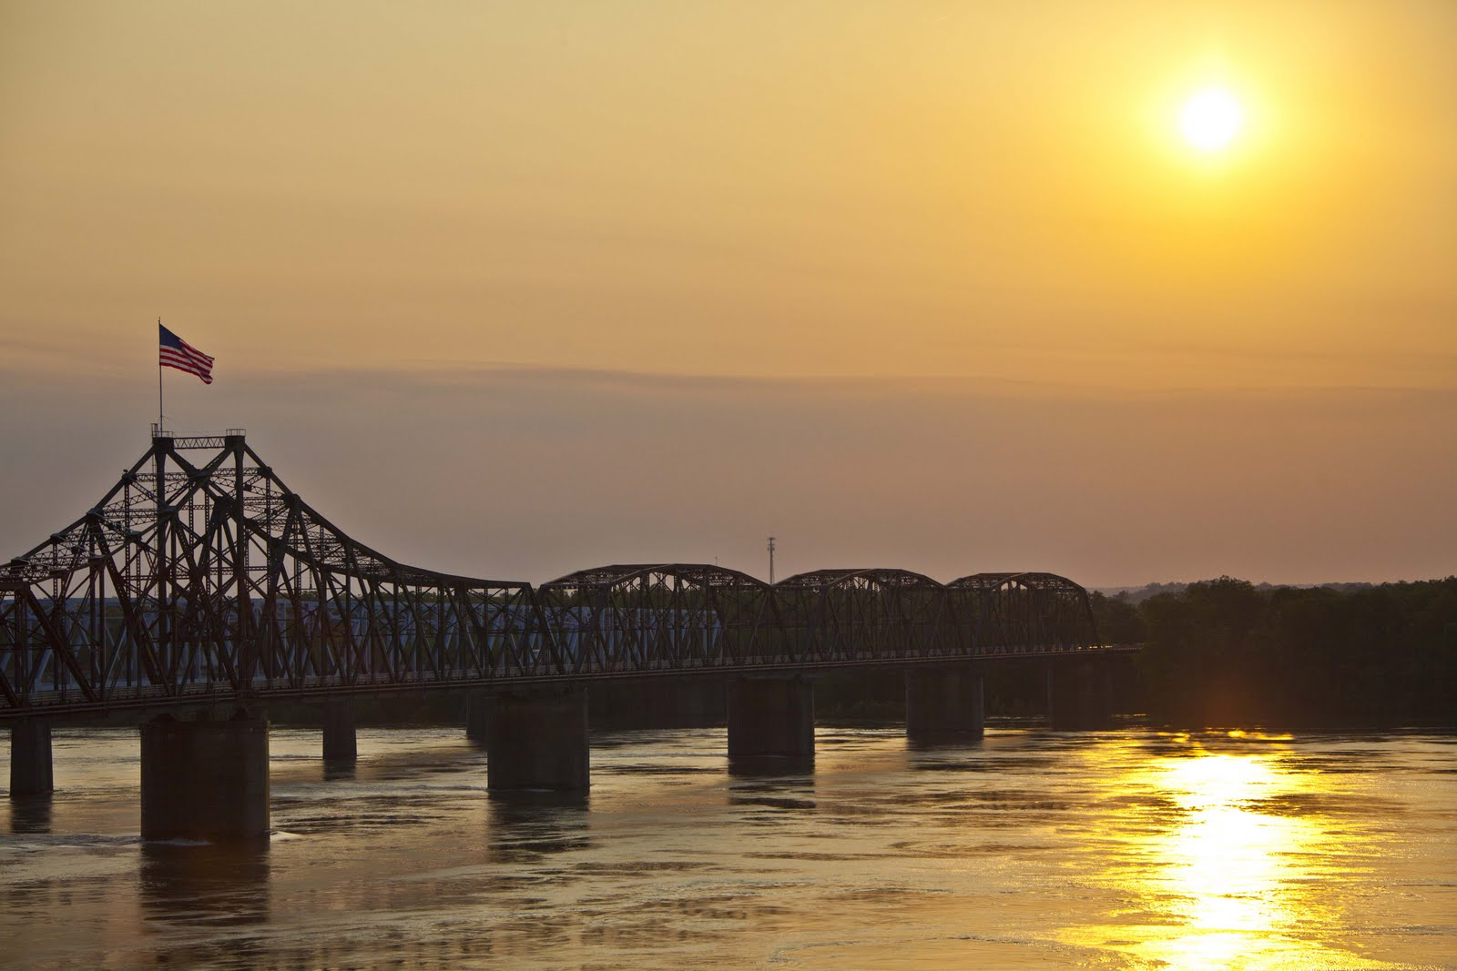
LEARNING OBJECTIVES
Using the course manual, references and lecture notes, the student will be able to understand hydrologic and hydraulic aspects of dam safety program. After this presentation, the student will be familiar with concepts, terminology and inter-relationships between hydrologic, hydraulic and water management considerations essential in the engineering analysis associated with the administration of the USACE Dam Safety program.
PERGUNTAS

